Slide 1

Unpacking IPAC’18
James Gerity
May 18, 2018
Slides available at http://www.github.com/jgerity/talks

Slide 2
IPAC
International Particle Accelerator Conference
Over 1,300 (!) registrants from labs and universities around the world
Typical paper/poster + contributed talks format
Pre-press is already online http://ipac2018.vrws.de/

Slide 3
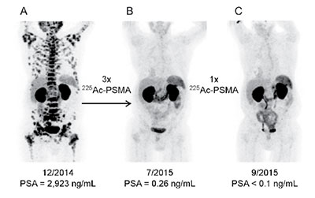
TRIUMF and radioisotopes
TRIUMF interested in producing radioisotopes for medical imaging and therapy
Start-up ARTMS recently received $3M funding
Prostate cancer patient before (left) and after (middle, right) successive treatments with prostate-specific membrane antigen (PSMA) with α-emitting ²²⁵Ac attached.
Figure from C. Kratochwil et al., 2016, http://dx.doi.org/10.2967/jnumed.116.178673
Notes:
Private spin-off ARTMS $3M funding

Slide 4
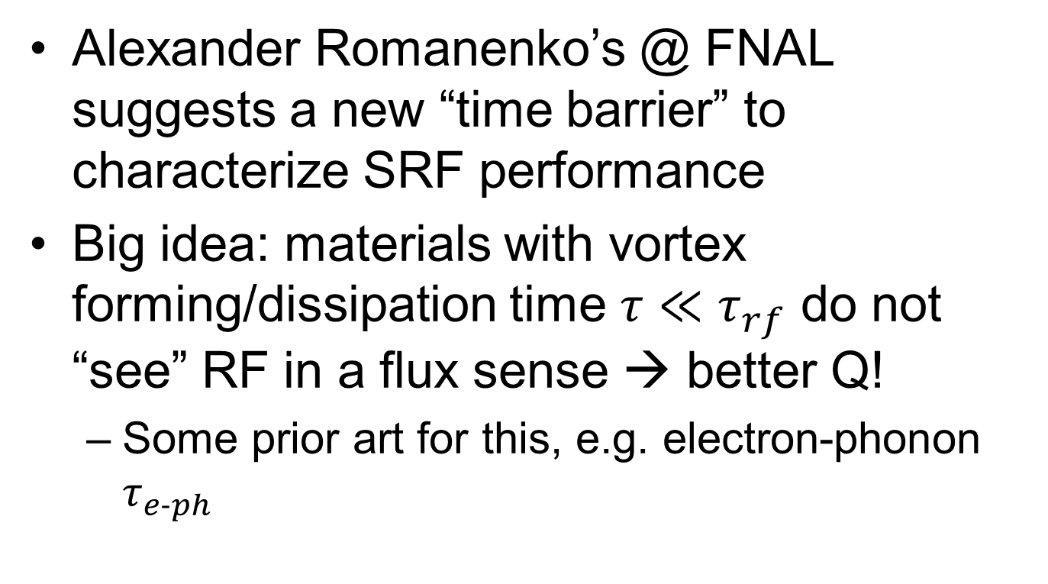
Microphysics of niobium SRF (WEYGBF2)
Alexander Romanenko’s @ FNAL suggests a new “time barrier” to characterize SRF performance
Big idea: materials with vortex forming/dissipation time $τ≪τ_{rf}$ do not “see” RF in a flux sense → better Q!
Some prior art for this, e.g. electron-phonon $τ_{e−ph}$

Slide 5
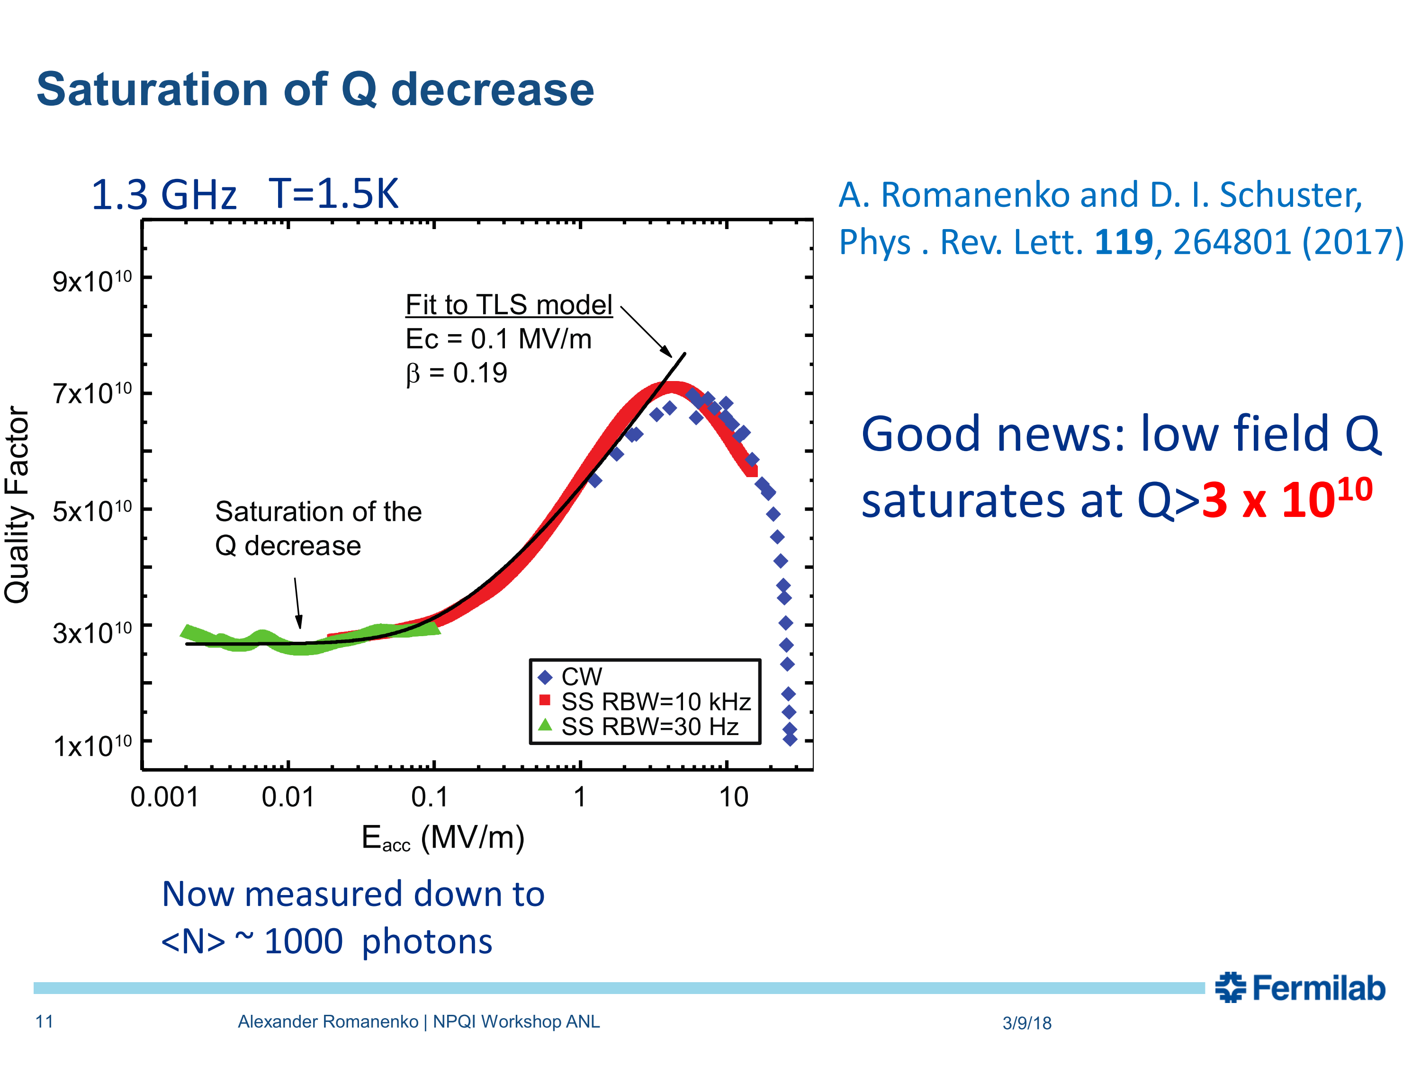
Q at low fields is well-described by a two-level system (TLS) model
Slide taken from A. Romanenko’s presentation (WEYGBF2) @ IPAC’18

Slide 6
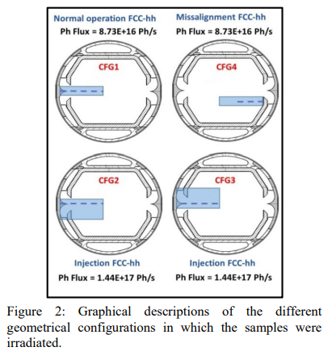
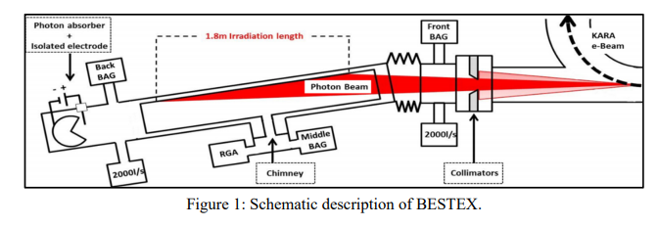
Beam screen R&D for HE-LHC, FCC-hh, etc. (MOZGBE5)
FCC-hh has synchrotron radiation power of 32 W/m
Requires a new design!
Reflector design has been tested: BESTEX @ KARA
Figures taken from MOZGBE5 @ IPAC’18

Slide 7
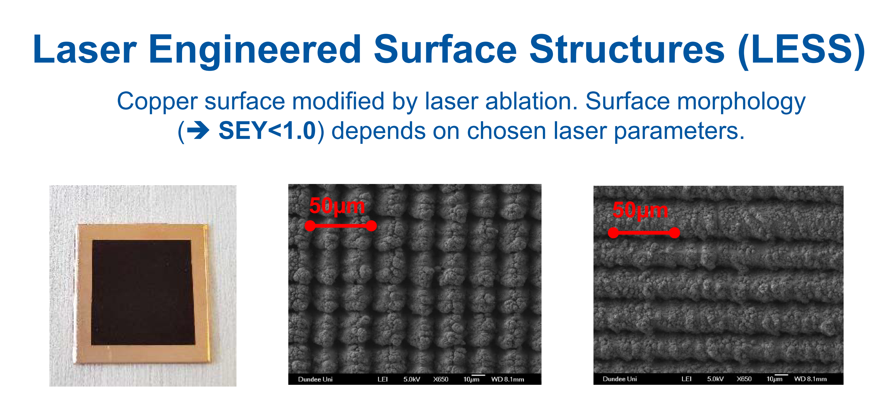
Beam screen R&D for HE-LHC, FCC-hh, etc. (TUZGBE3, WEPMG005)
Problem: reduce surface e⁻ yield (SEY) to reduce heat load
Slide taken from M. Sitko’s presentation (TUZGBE3) @ IPAC’18

Slide 8
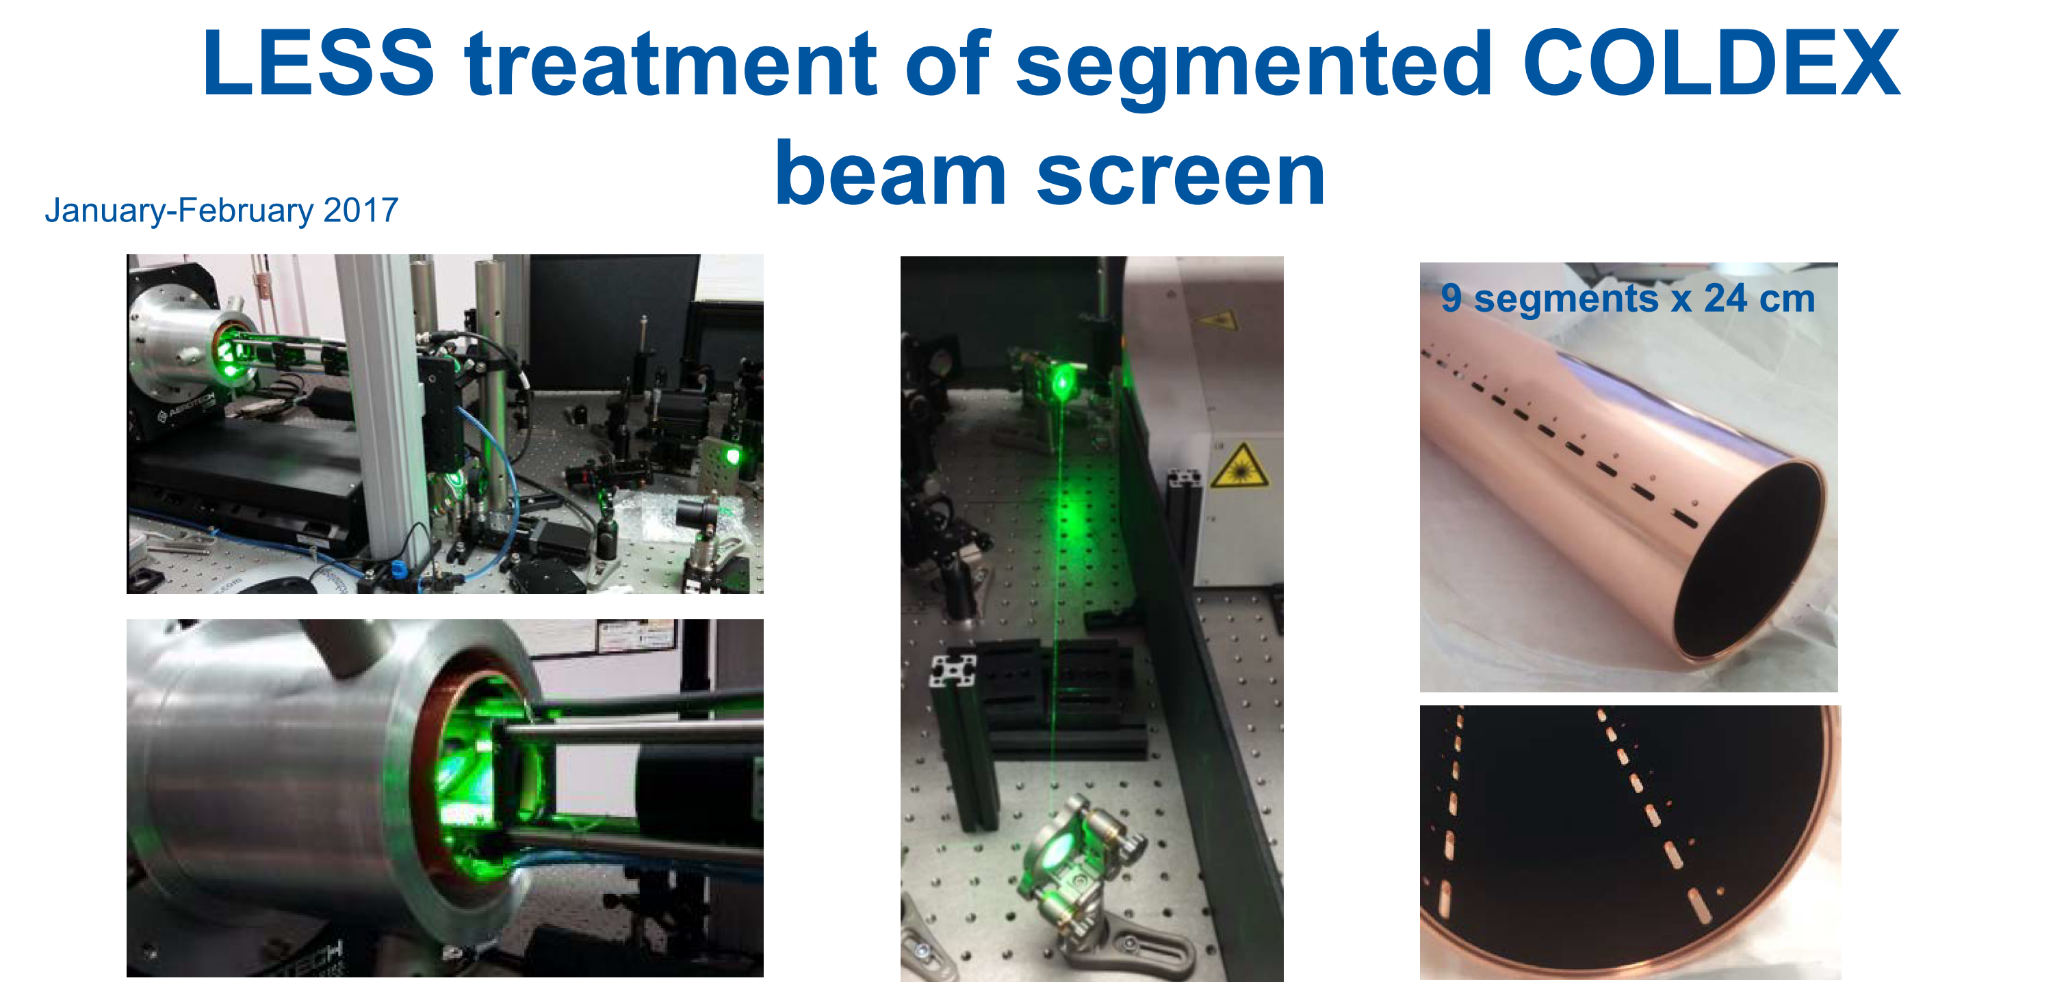
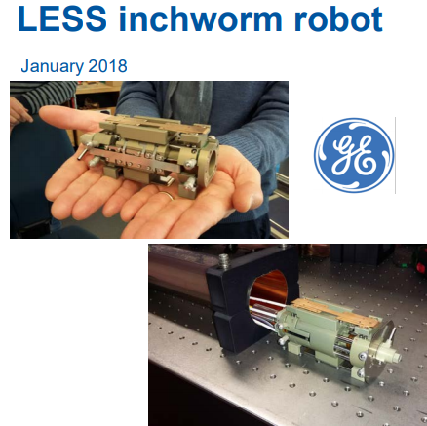
Beam screen R&D for HE-LHC, FCC-hh, etc. (TUZGBE3, WEPMG005)
Treatment tested @ SPS, observed no electron cloud! Still very slow method…
Slides taken from M. Sitko’s presentation (TUZGBE3) @ IPAC’18

Slide 9
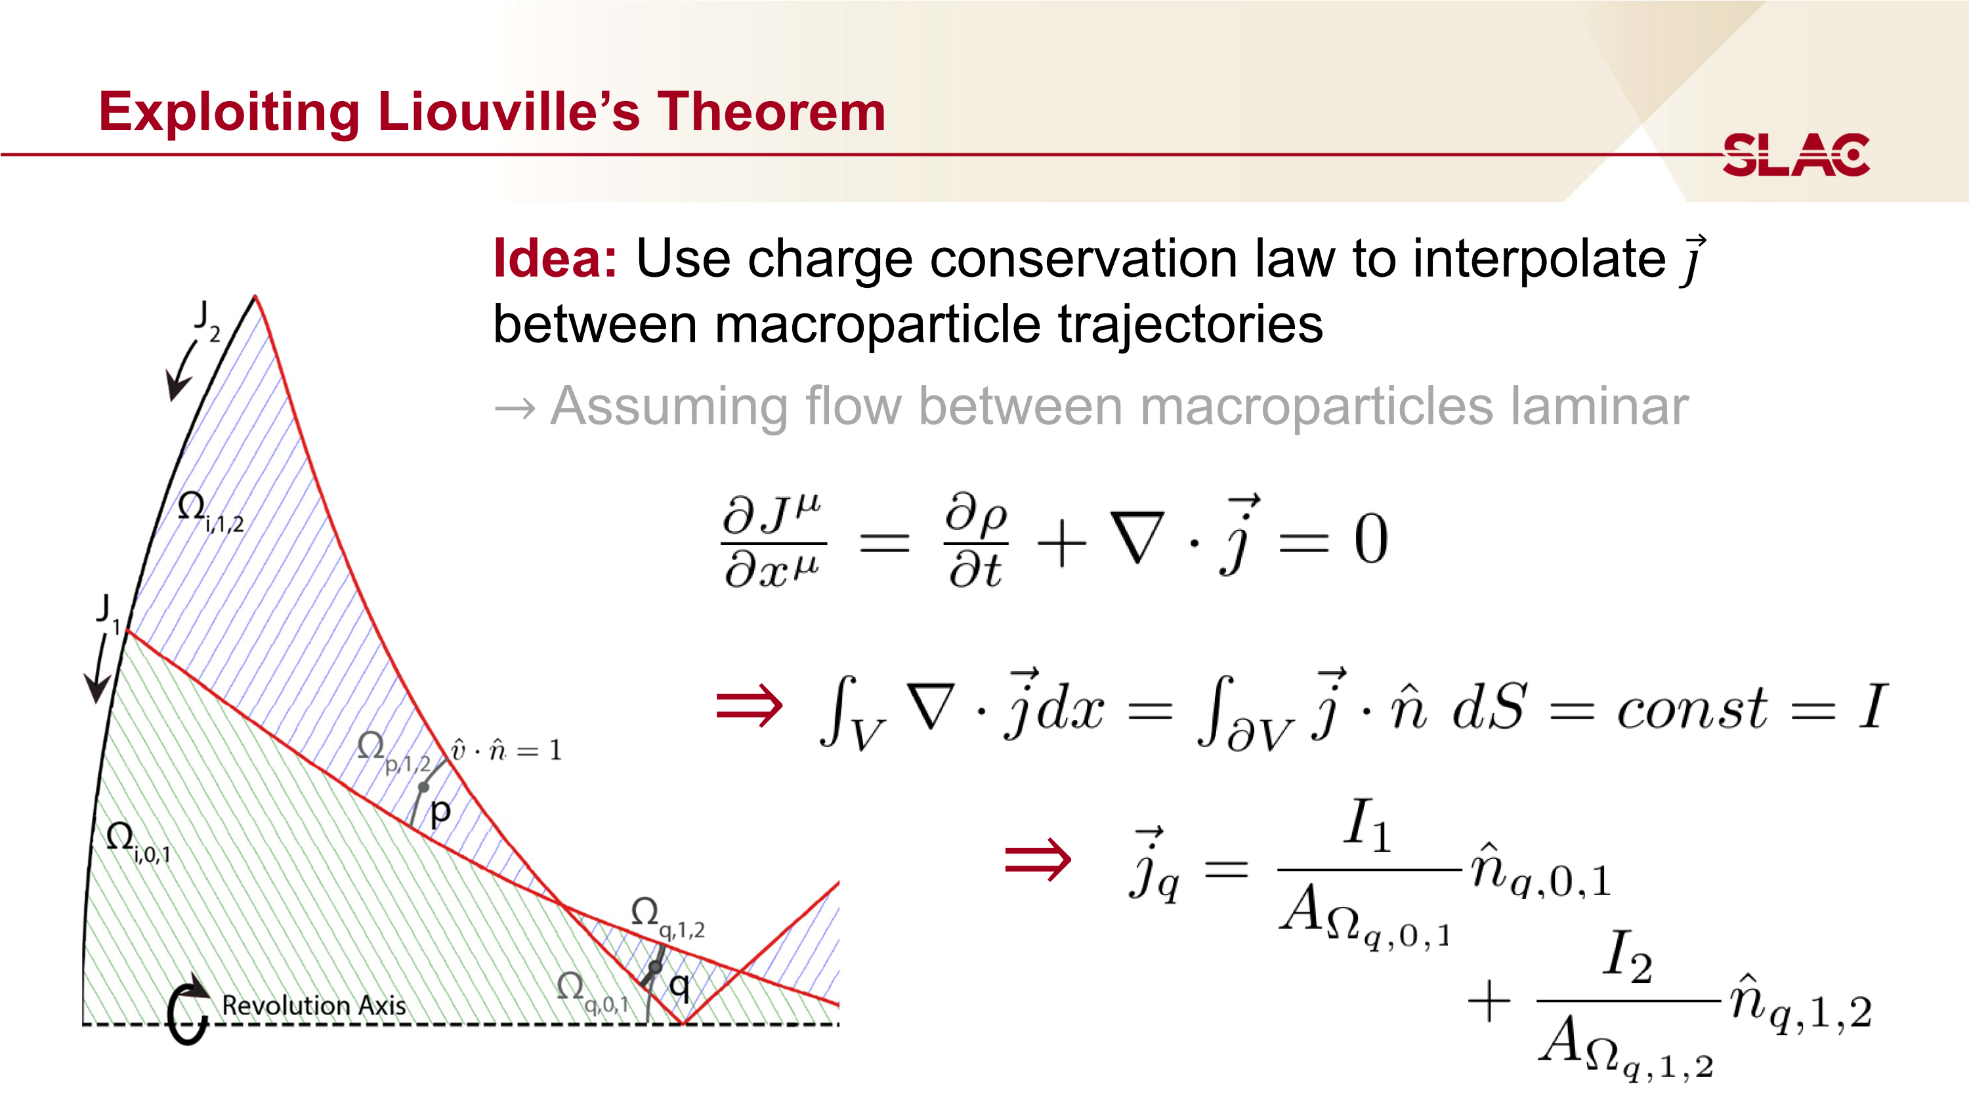
New approach to space-charge simulation (TUYGBD5)
Slide taken from A. Gold’s presentation (TUYGBD5) @ IPAC’18

Slide 10
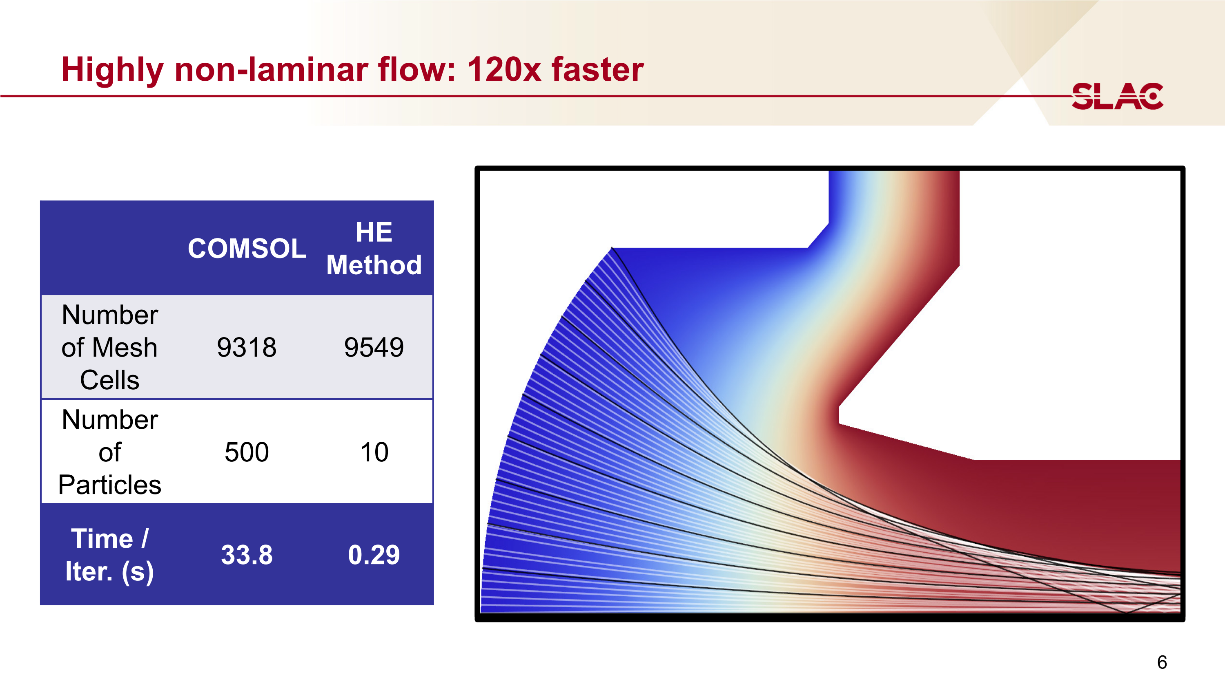
New approach to space-charge simulation (TUYGBD5)
Slide taken from A. Gold’s presentation (TUYGBD5) @ IPAC’18

Slide 11
CBETA (TUYGBE2)
Cornell-BNL ERL Test Accelerator (CBETA) “will be the first ever multi-turn ERL with superconducting RF (SRF) acceleration, and the first ERL based on Fixed Field Alternating Gradient (FFAG) optics”
Important implications for JLEIC and eRHIC

Slide 12
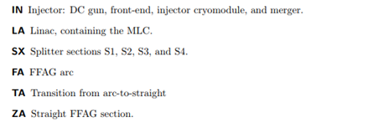
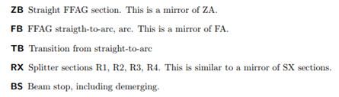
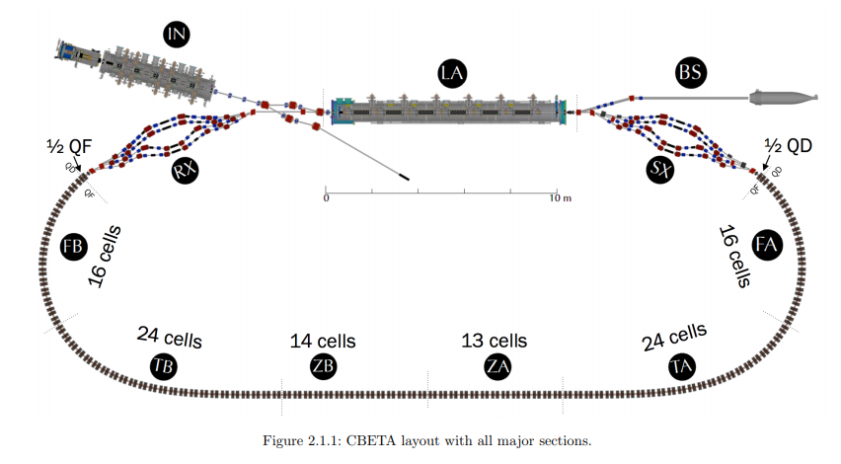
CBETA (TUYGBE2)
Figure taken from CBETA Design Report

Slide 13
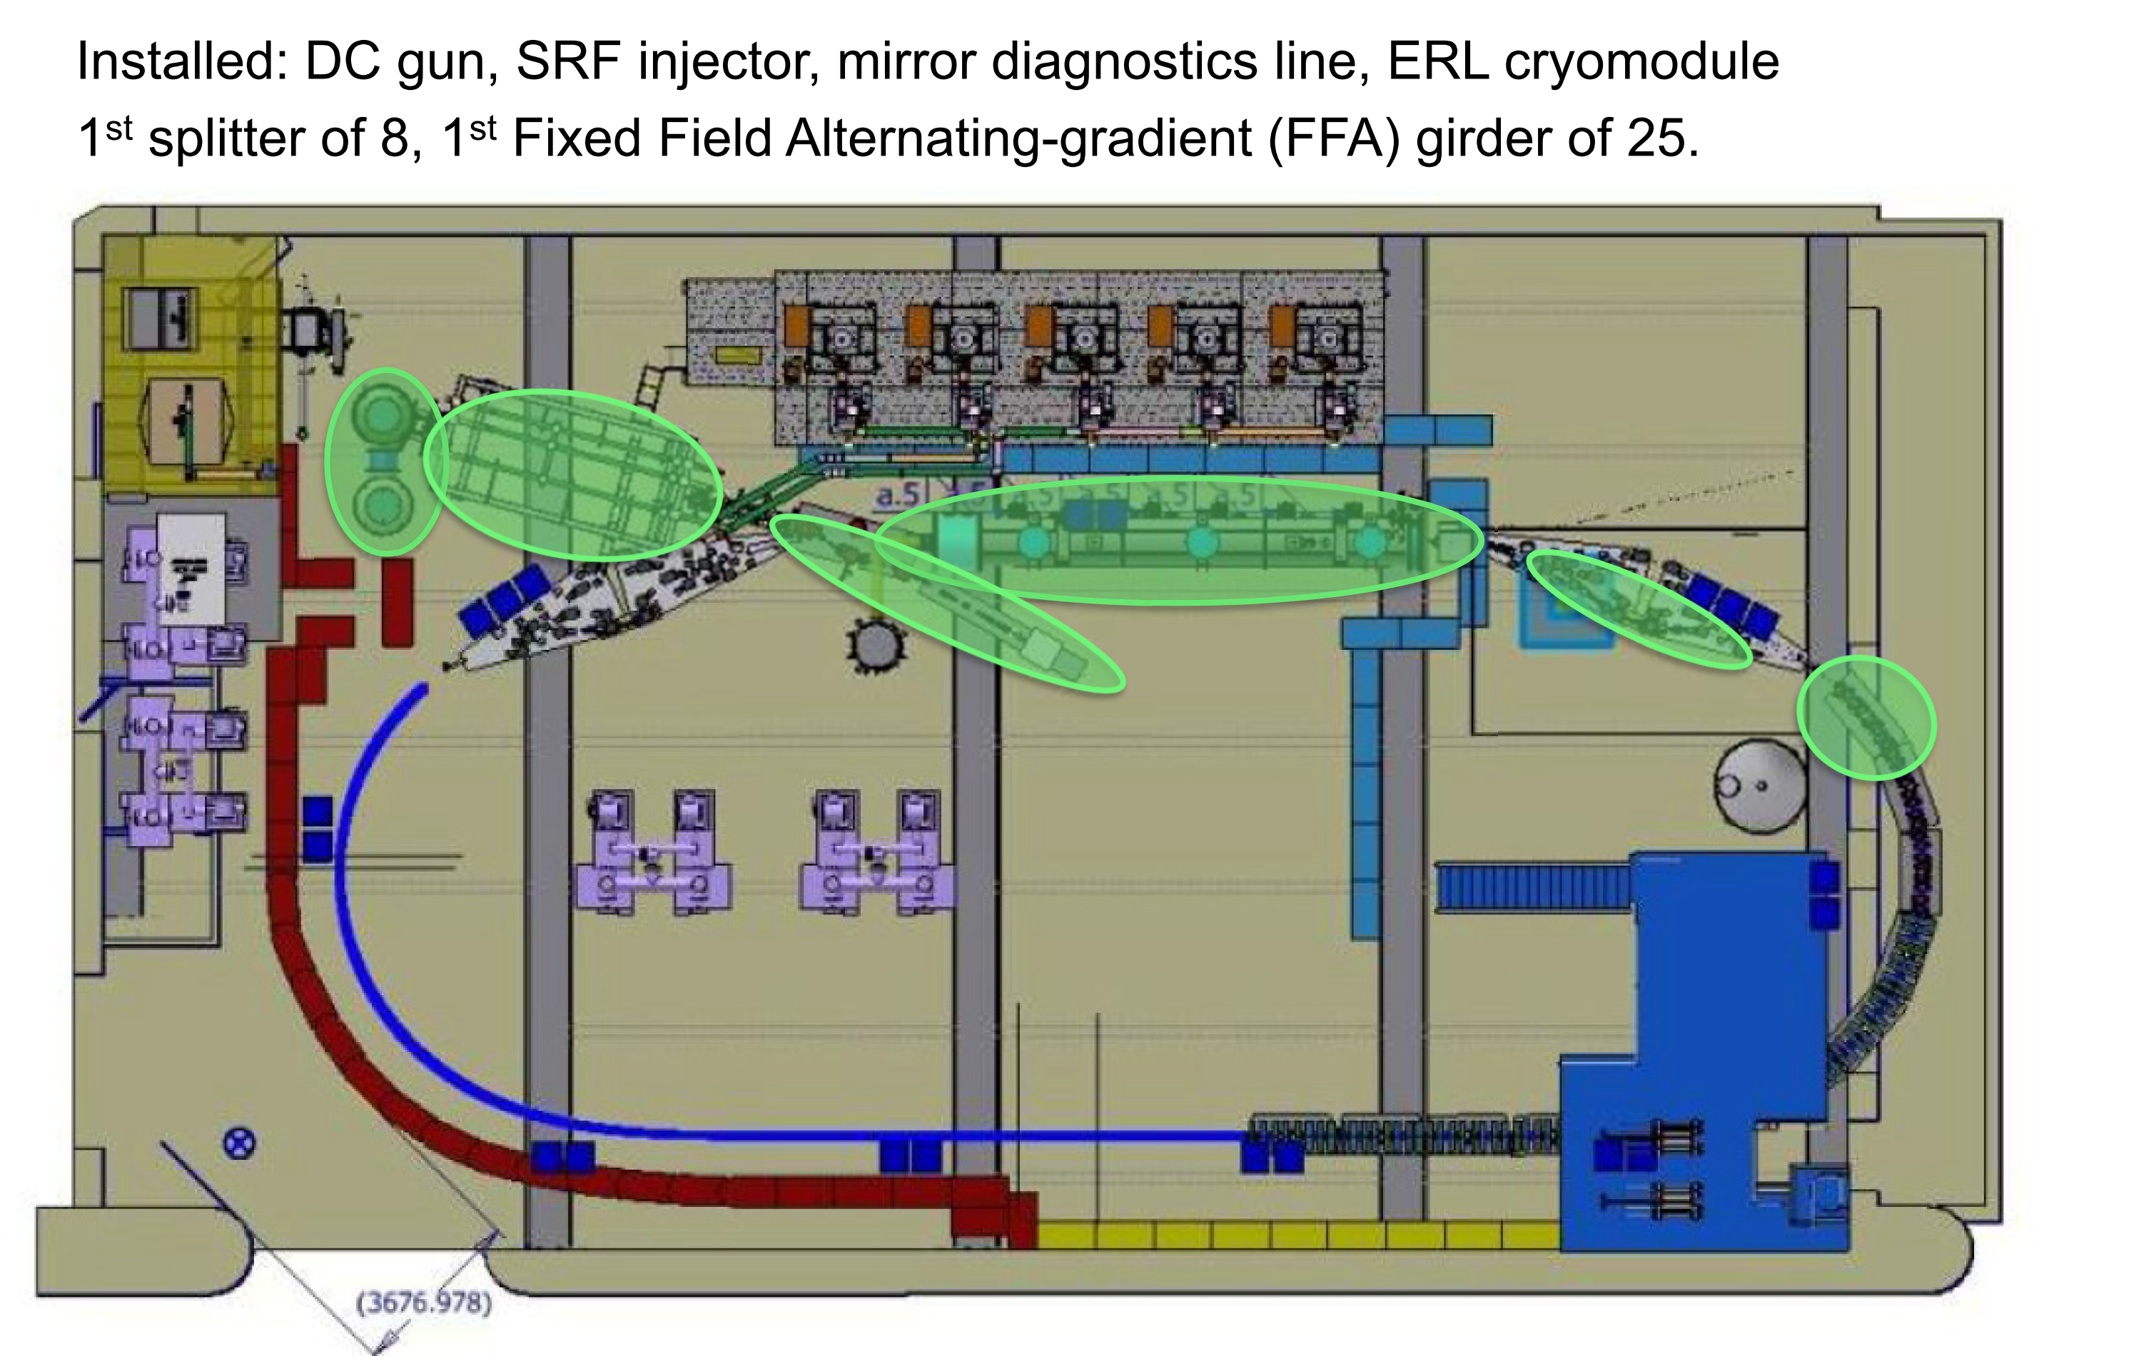
CBETA (TUYGBE2)
Slide taken from G. Hoffstaetter’s presentation @ IPAC’18

Slide 14
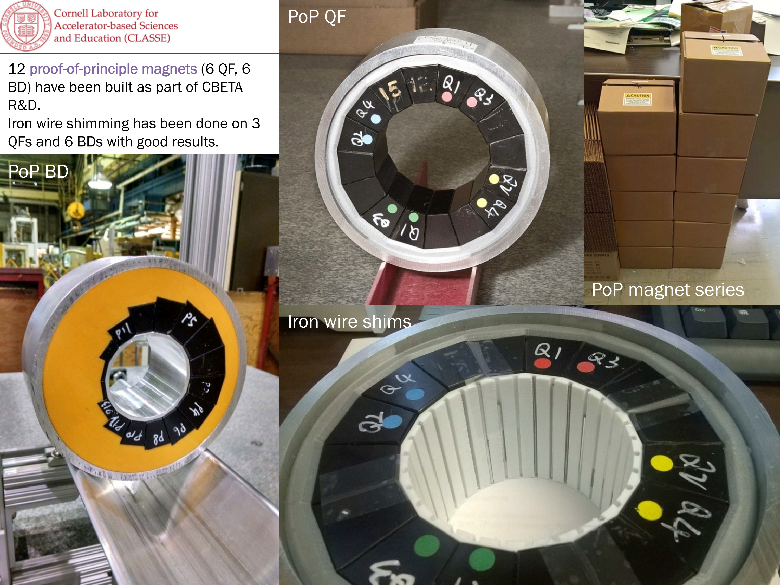
CBETA (TUYGBE2)
Slide taken from G. Hoffstaetter’s presentation @ IPAC’18

Slide 15
eRHIC design status (TUYGBD3)
Collects lots of parameters that have been slightly hard to come by in a single document
Pre-CDR expected by end of June
Strong hadron cooling is active R&D
CBETA and coherent cooling proof-of-principle experiment @ RHIC

Slide 16
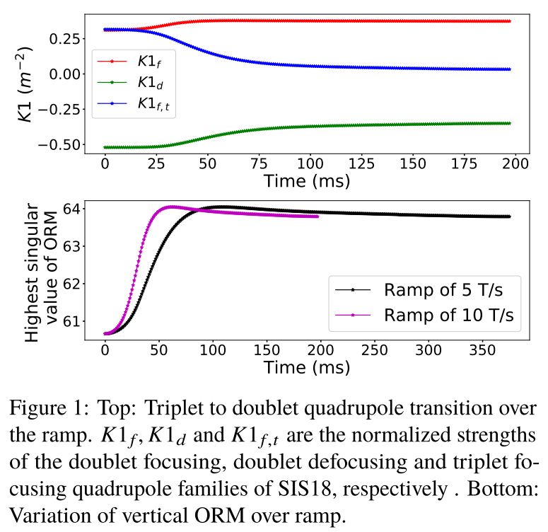
SIS-18 ORM (WEPAK003)
SIS-18 at FAIR (GSI) has a complex ramp
Smooth transition from doublet to triplet optics
Characterization of orbit response matrix (ORM) over this ramp
Figure taken from WEKPAK003 @ IPAC’18

Slide 17
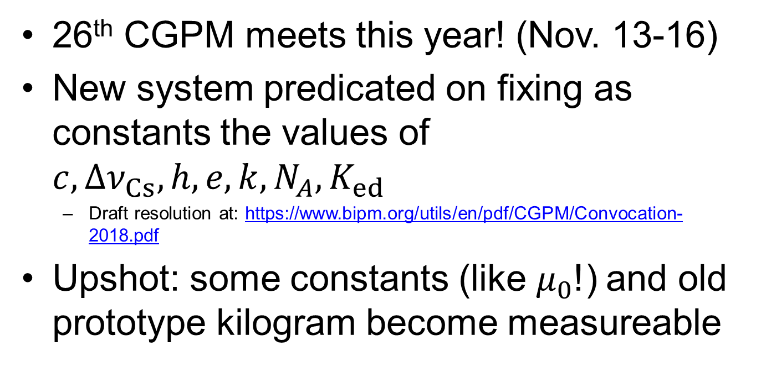
Entertainment talk: chief metrologist of CA
26th CGPM meets this year! (Nov. 13-16)
New system predicated on fixing as constants the values of $c, Δν_{Cs},h,e,k,N_{A},K_{ed}$
Draft resolution at: https://www.bipm.org/utils/en/pdf/CGPM/Convocation-2018.pdf
Upshot: some constants (like $μ_{0}$!) and old prototype kilogram become measureable

Slide 18
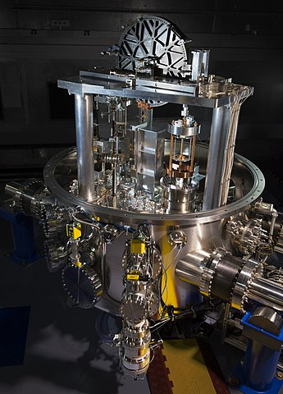
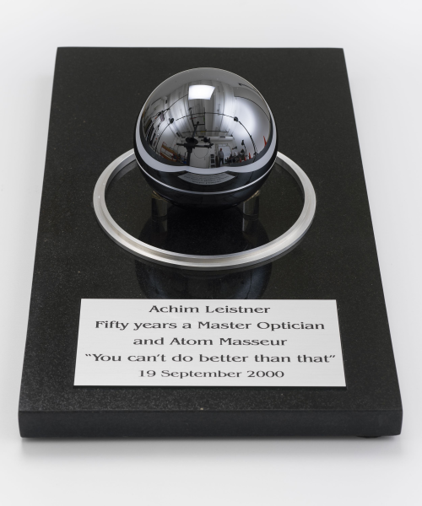
Entertainment talk: chief metrologist of CA
Image by Jennifer Lauren Lee (NIST). Used under Public Domain, retrieved from https://commons.wikimedia.org/w/index.php?curid=62335811
Image courtesy of the Museum of Applied Arts & Sciences, under CC BY-NC-ND 4.0. https://collection.maas.museum/object/539785

Slide 19
UFOs in LHC (THYGBD2)
Type I known for several years
Type II observed in 2017, fast gas instability after initial peak
Specific location at a magnetic interconnect, believed to be vacuum contaminated with air → frozen nitrogen macroparticles on beam screen

Slide 20
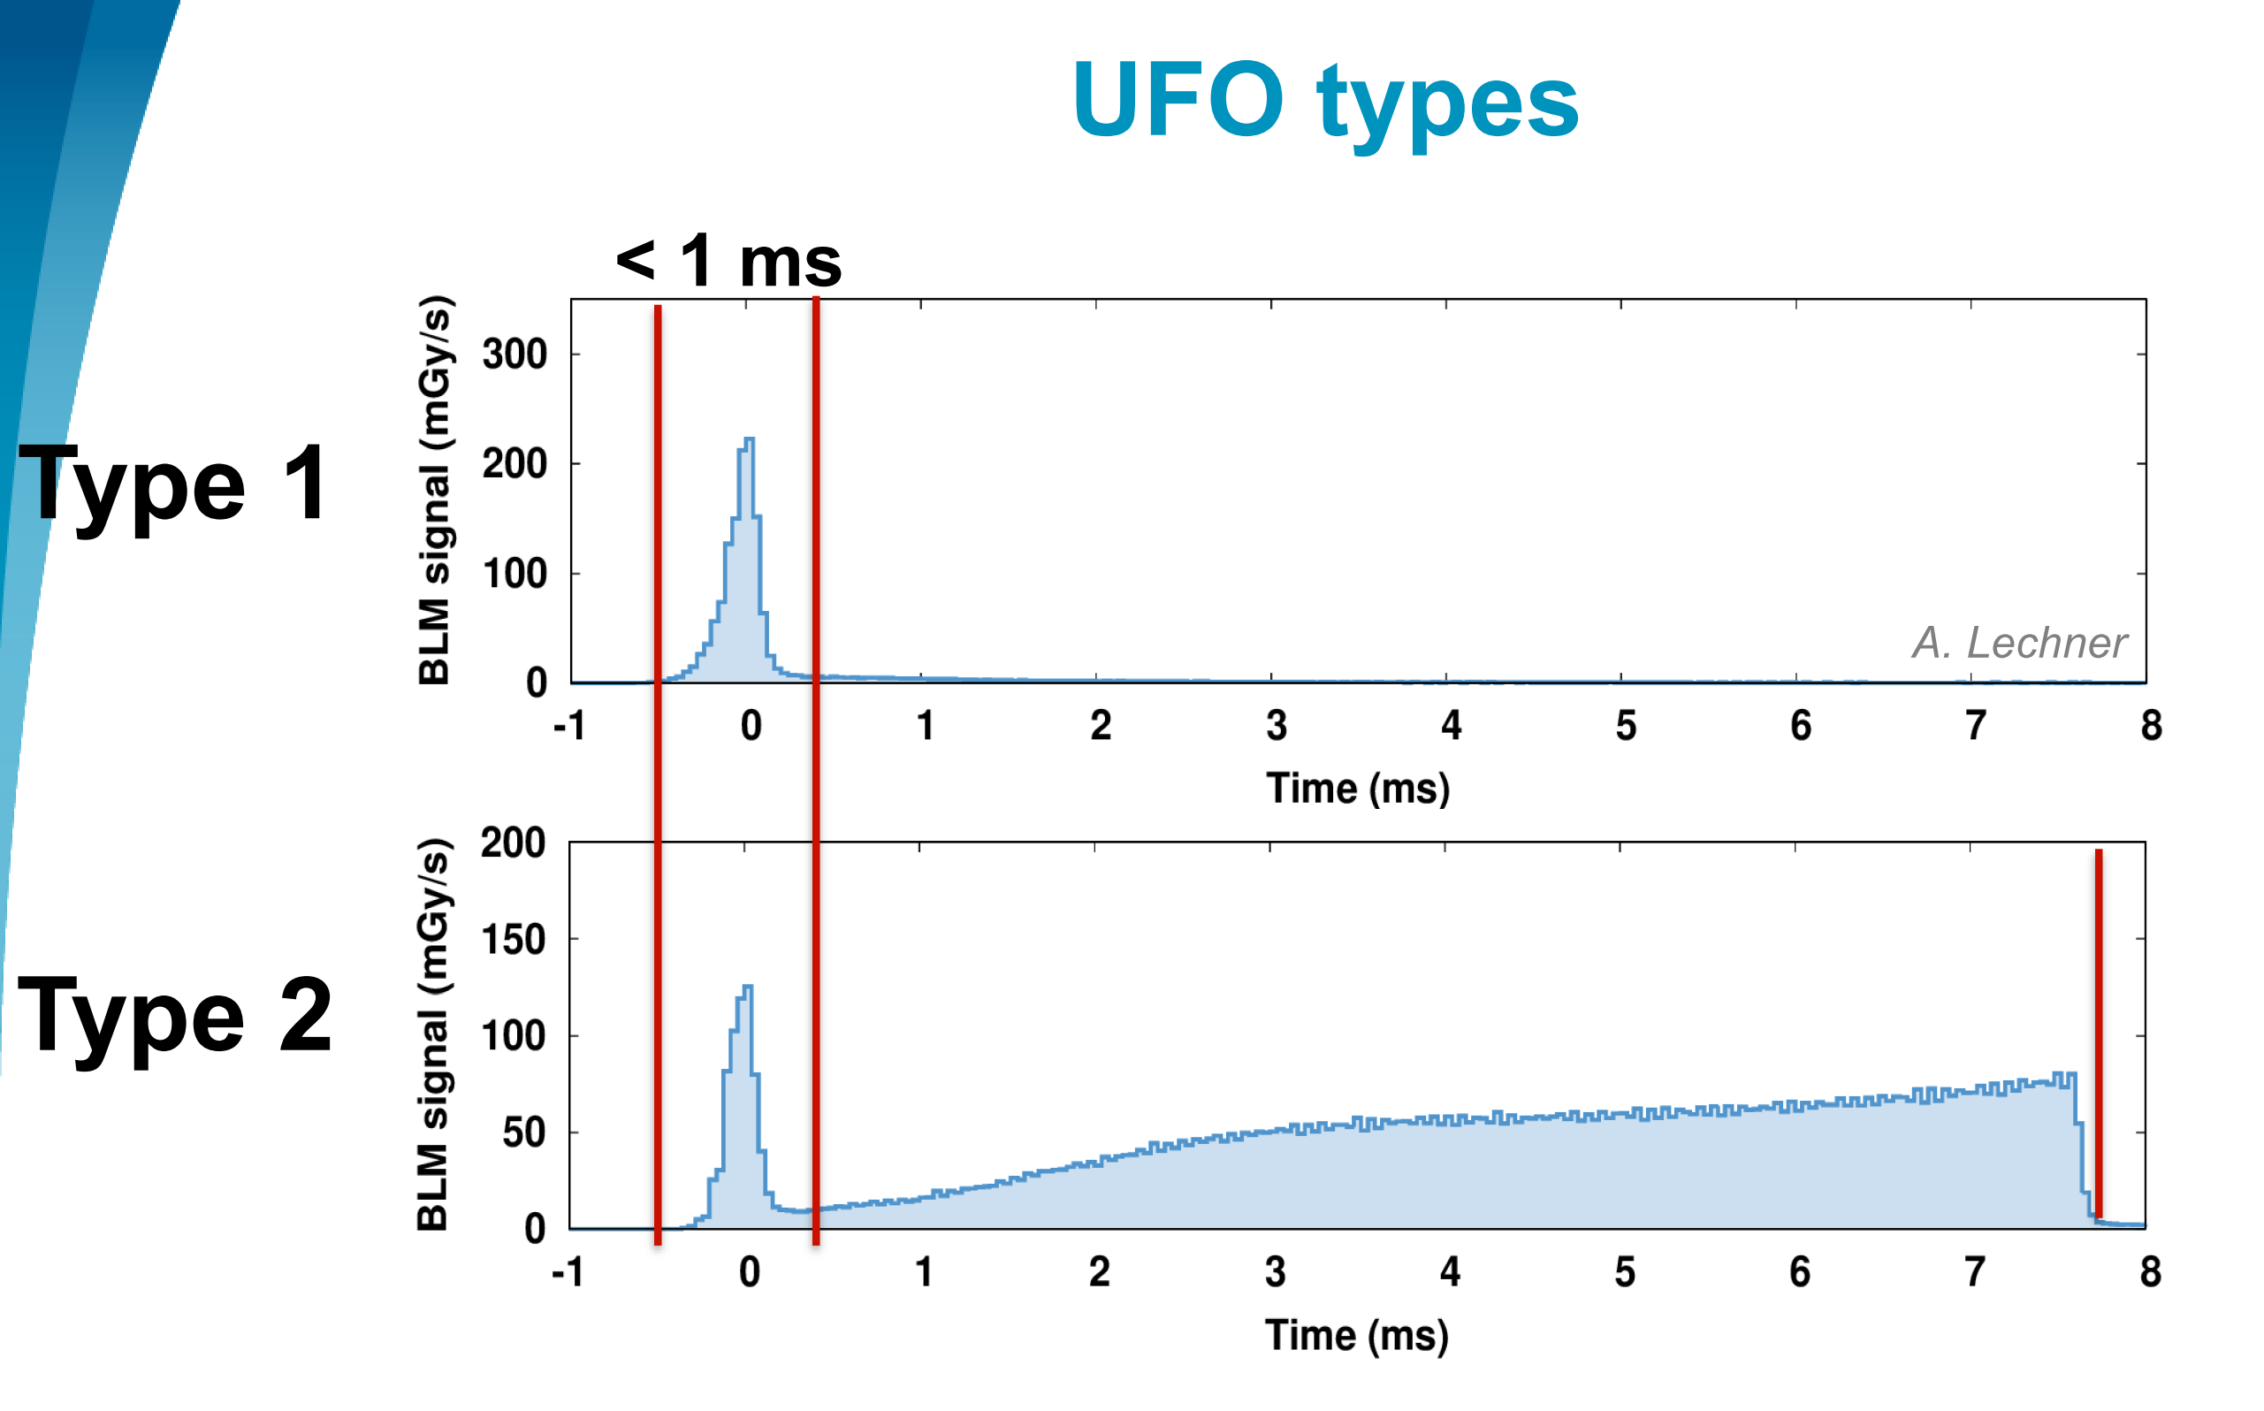
UFOs in LHC (THYGBD2)
Slide taken from B. Lindstrom’s presentation @ IPAC’18

Slide 21
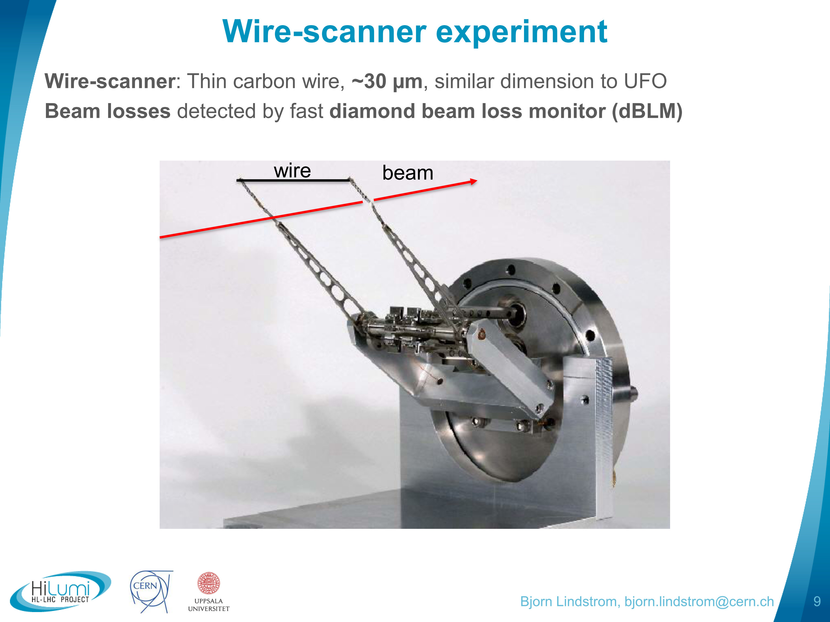
UFOs in LHC (THYGBD2)
Slide taken from B. Lindstrom’s presentation @ IPAC’18

Slide 22
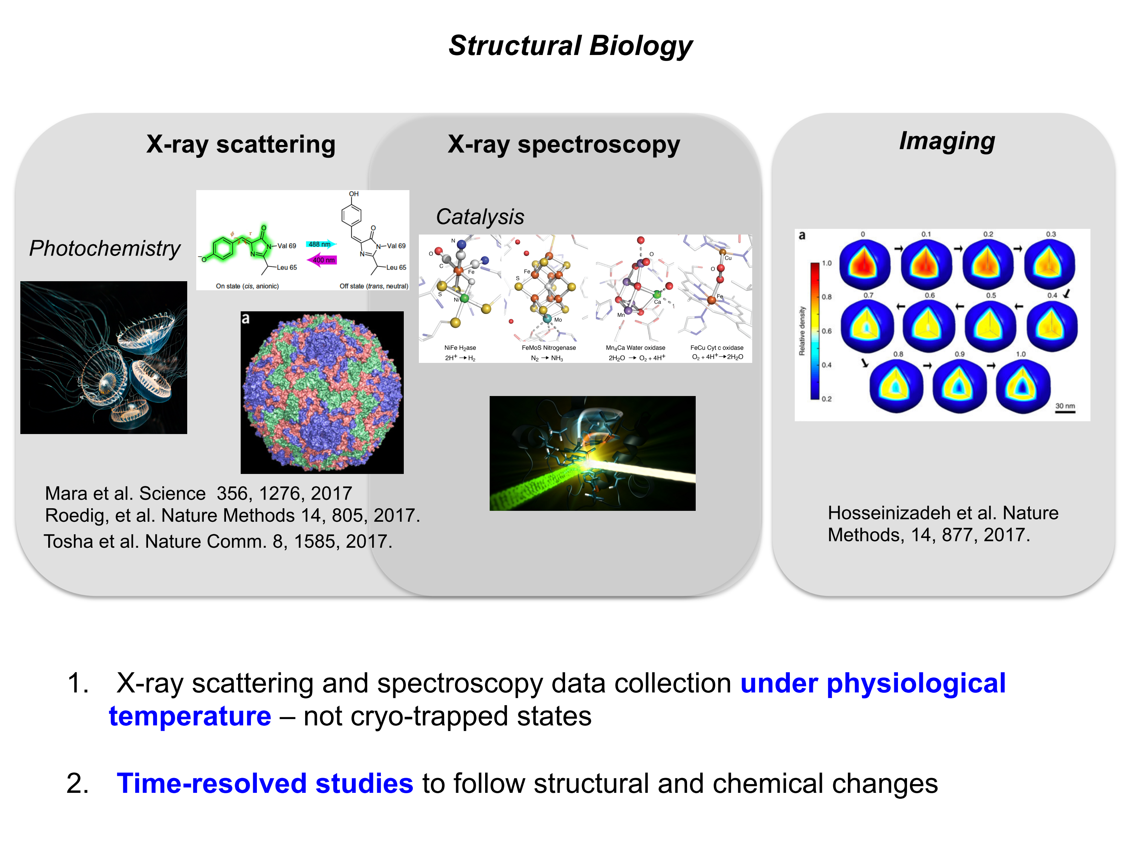
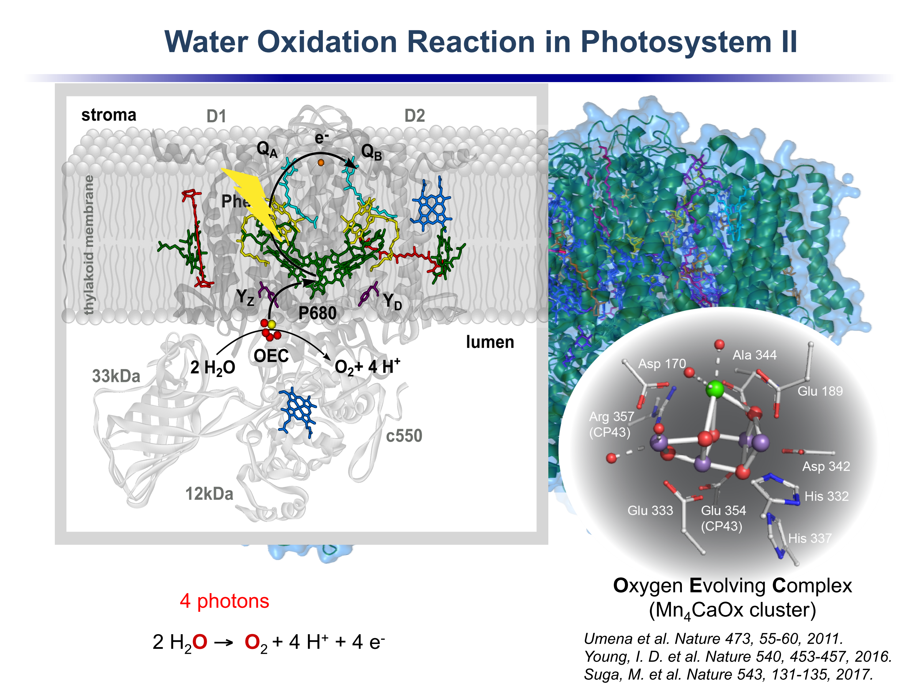
Review of FEL science (FRYGB1)
Many excellent studies done at LCLS and other facilities
Slides taken from J. Yano’s presentation @ IPAC’18

Slide 23
Review of FEL science (FRYGB1)
J. Yano et al. have developed a very clever droplet-on-tape method for studying the behavior of OEC in Photosystem II
https://www.youtube.com/watch?v=J7es2VcJD6A

Slide 24
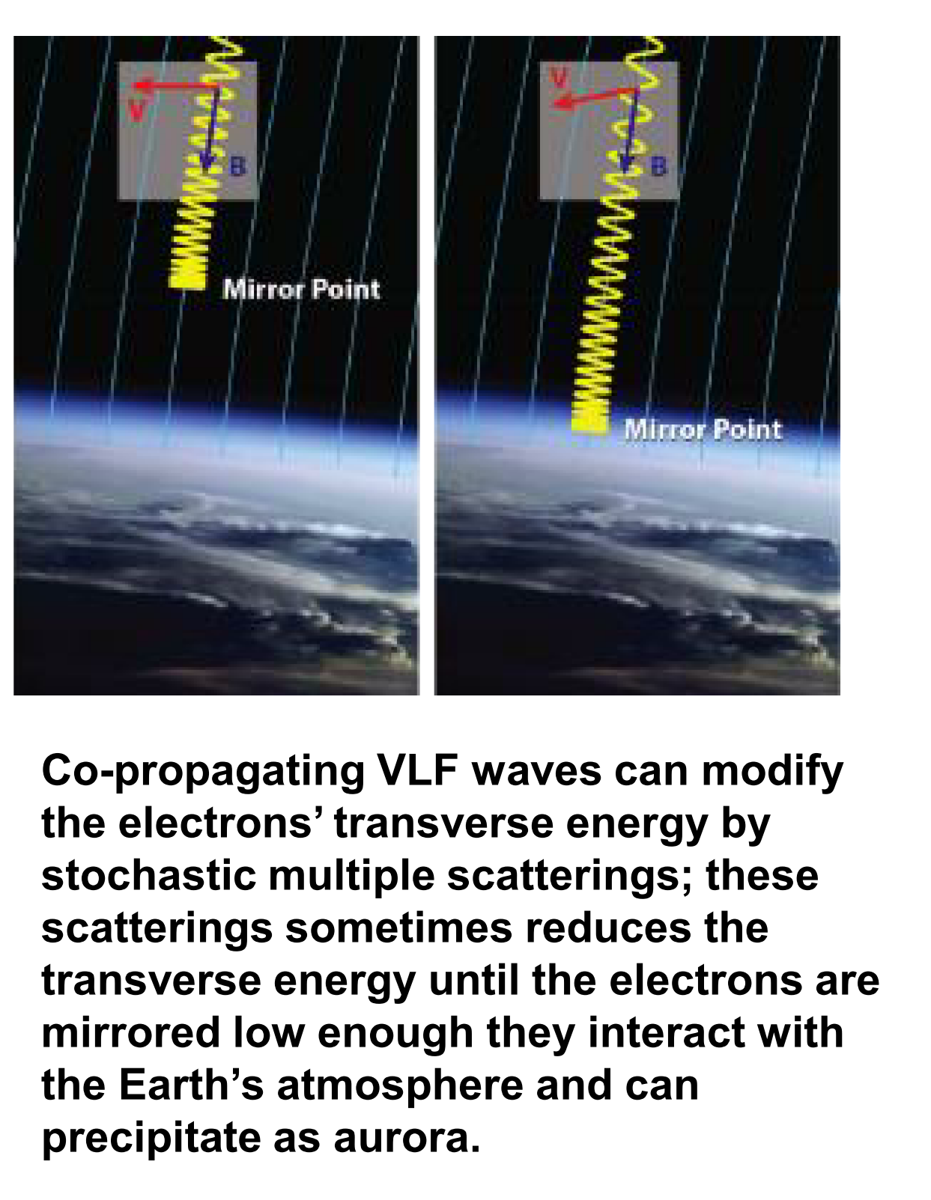
Accelerators as defense (FRYGB2)
High-altitude nukes → satellite e- damage
Starfish Prime (1962) killed Telstar I!
Defense sector wants a mitigation strategy
“shake” the e- out of belt with VLF waves
Figure taken from B. Carlsten’s presentation @ IPAC’18

Slide 25
Accelerators as defense (FRYGB2)
A compact e- accelerator in space could generate needed radiation
Terrestrial NSF experiment using 1 MeV linac from Lancaster University
characterize the fundamental beam physics
NASA Beam-PIE experiment mentioned
60 keV C-band RF accelerator
Cannot find any information about this…

Slide 26
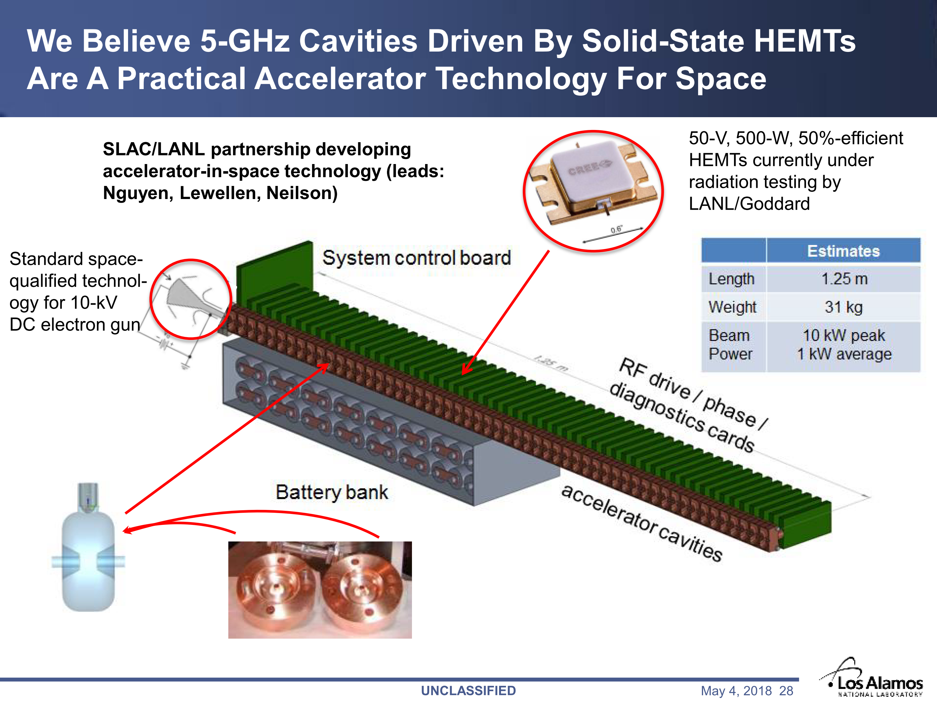
Accelerators as defense (FRYGB2)
Slide taken from B. Carlsten’s presentation @ IPAC’18

Slide 27
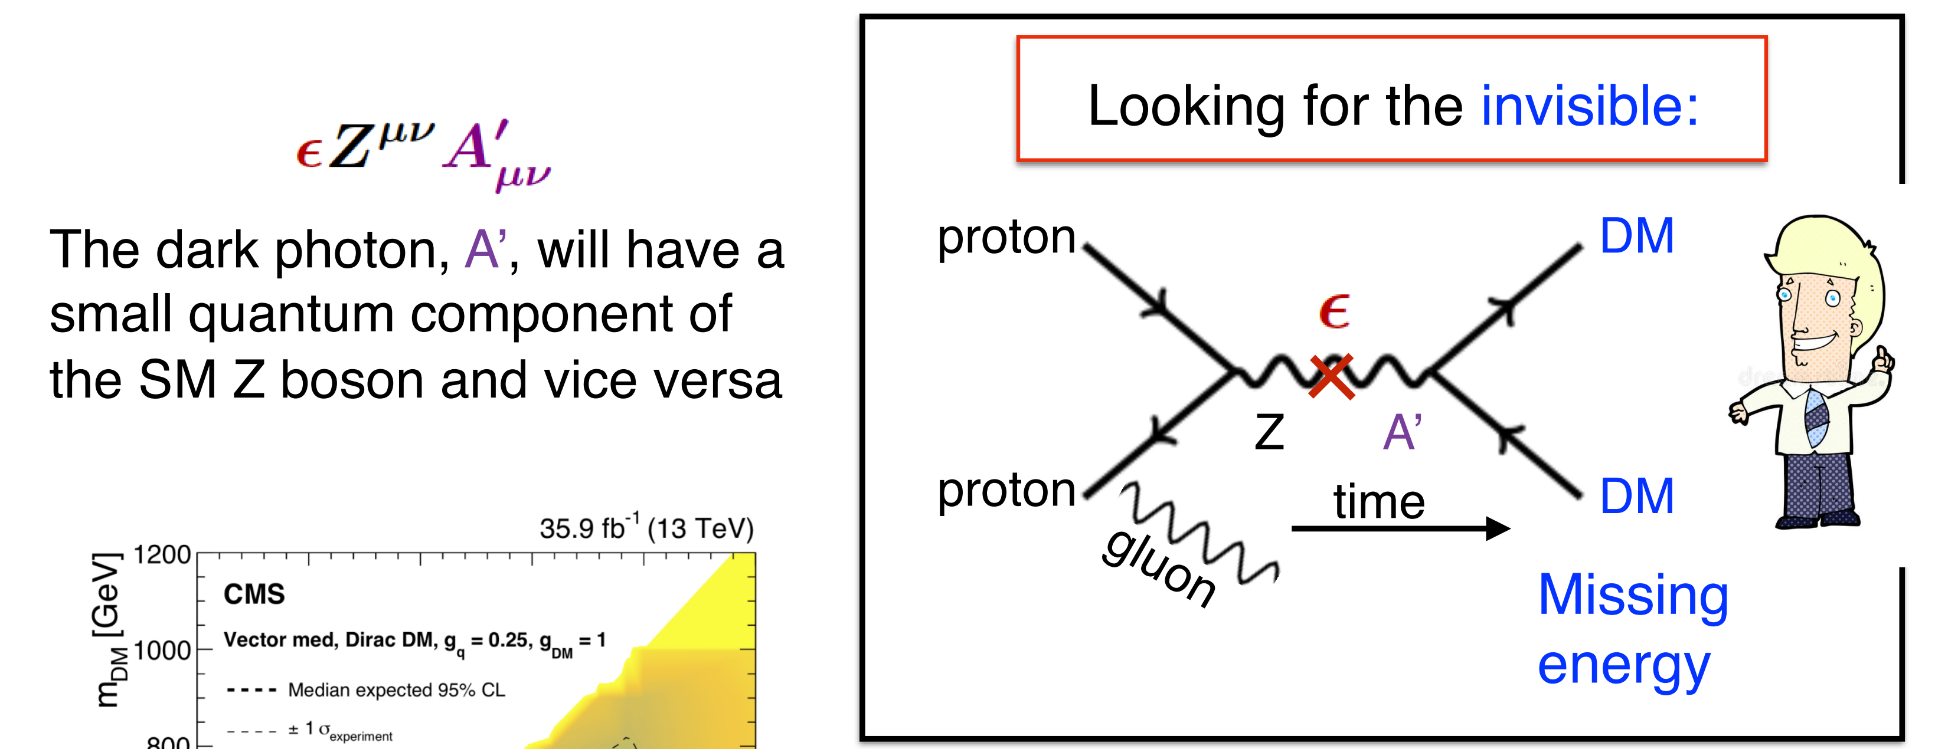
Dark sectors (FRYGB3)
Extremely good review of dark sector possibilities, current exclusion bounds, etc.
Slide taken from S. Gori’s presentation @ IPAC’18

Slide 28
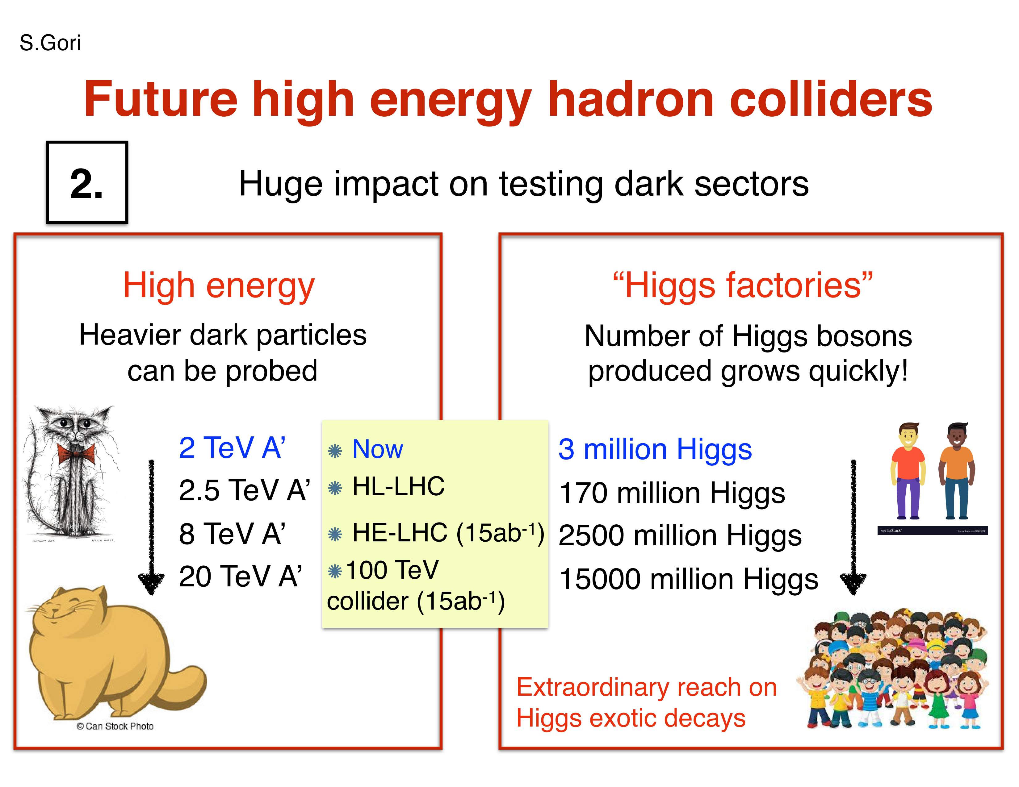
Dark sectors (FRYGB3)
Can also exploit Higgs’s natural interaction with dark matter
Slide taken from S. Gori’s presentation @ IPAC’18

Slide 29
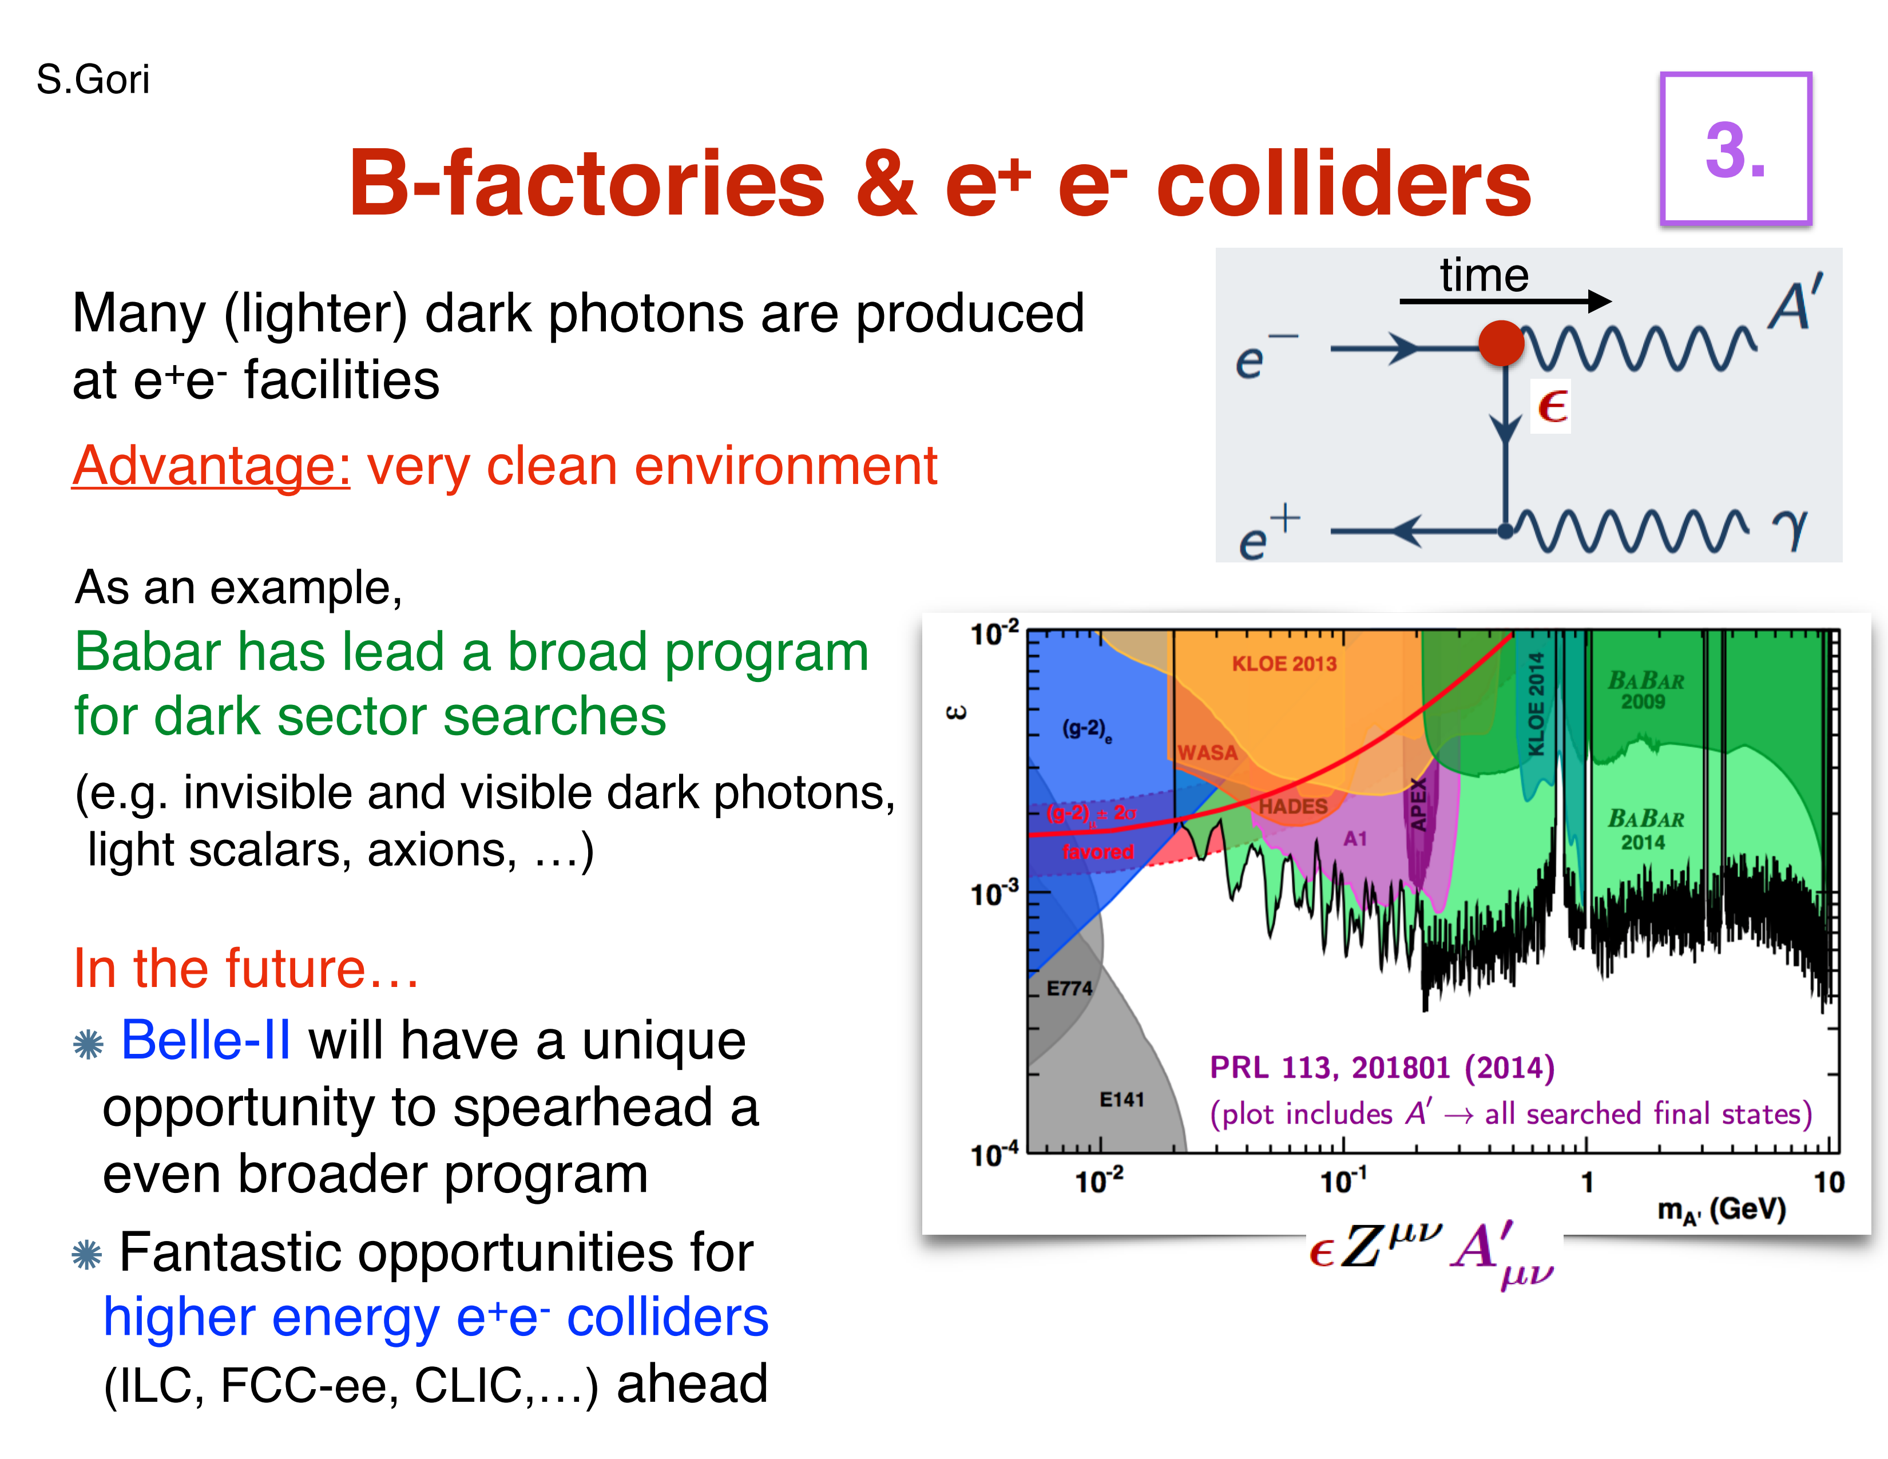
Dark sectors (FRYGB3)
Slide taken from S. Gori’s presentation @ IPAC’18

Slide 30
…and a whole bunch more
Pre-press is already online! http://ipac2018.vrws.de/

Slide 31
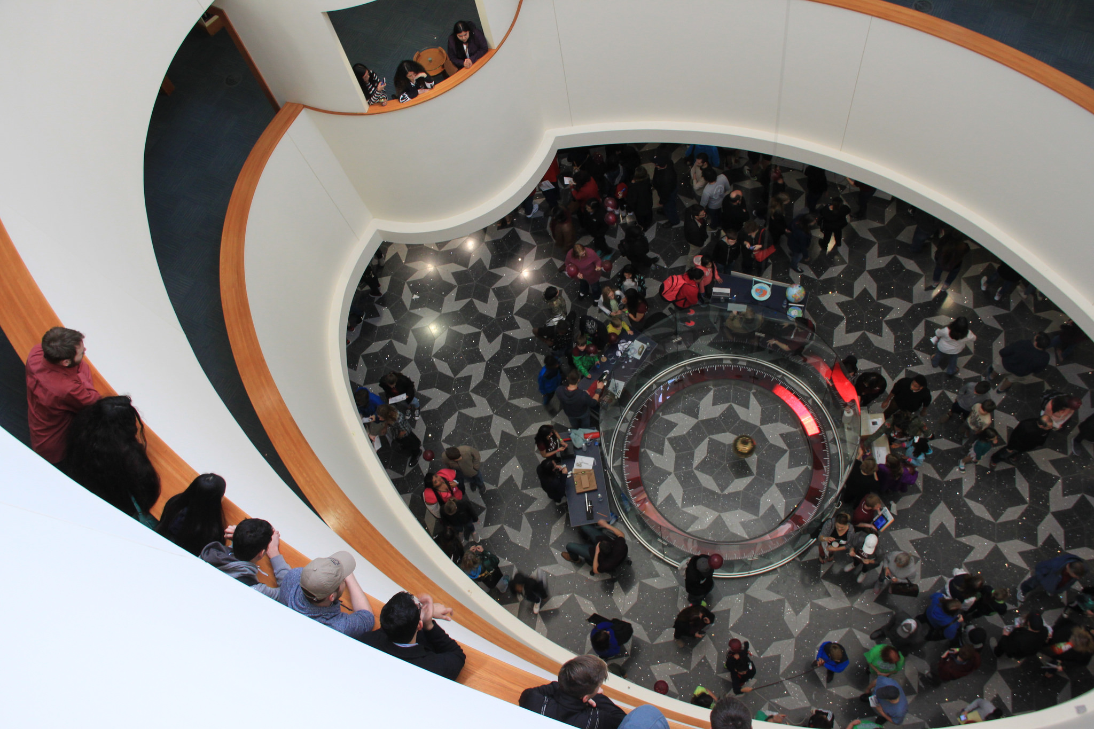
Thank you!

Slide 32
Backup Slides

Slide 33
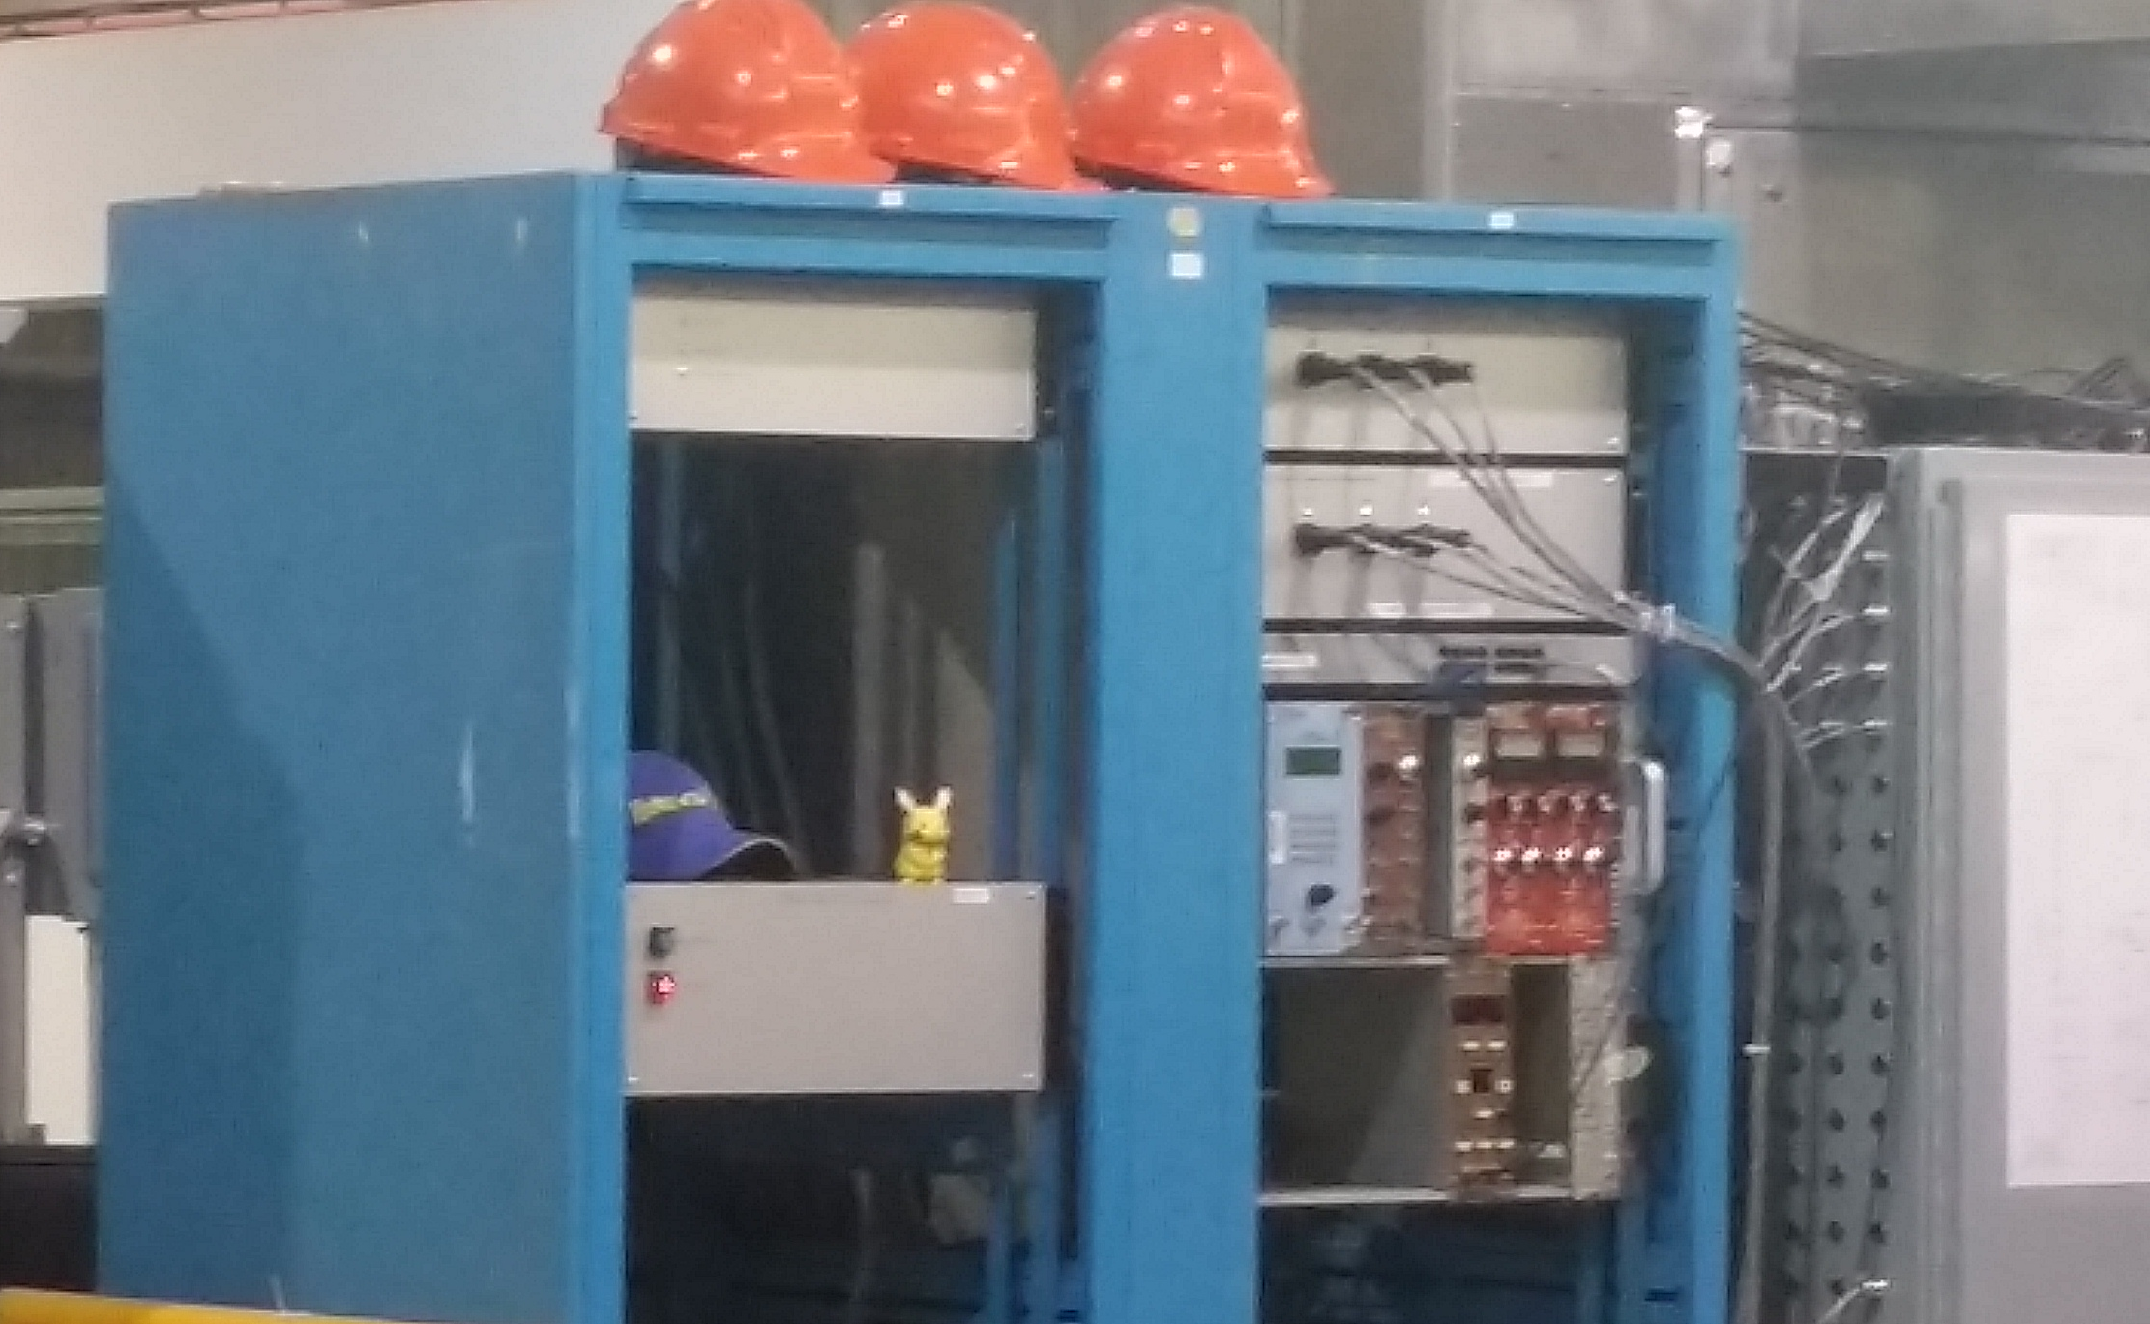
TRIUMF Tour
The TITAN team has a Pikachu figurine that they hide every shift for esprit de corps

